Slide 1
Capstone Project
Superstore Sales Dashboard Using Powerbi
By
Ravi Kumar

Slide 2
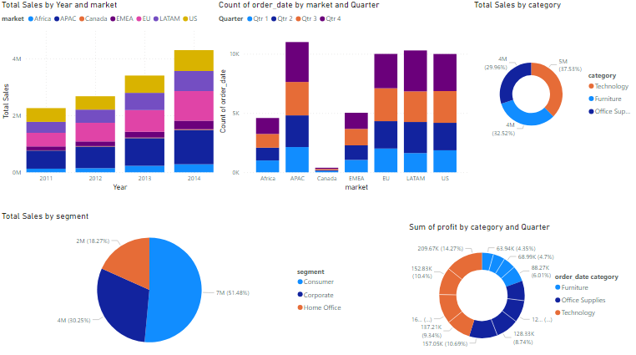
Sales Analysis Dashboard

Slide 3
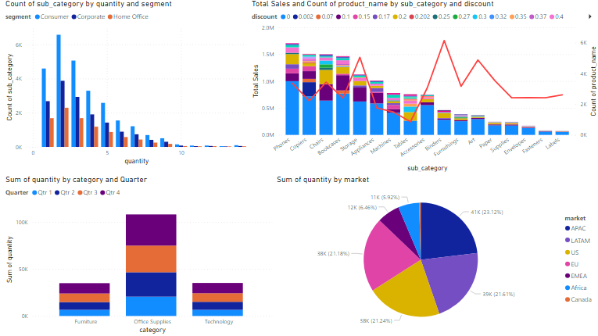
Product Analysis Dashboard

Slide 4
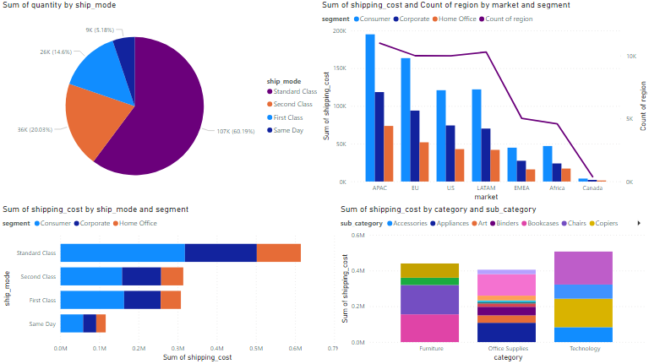
Shipping Analysis Dashboard

Slide 5
Conclusion
Expand market share
Boost sales to specific segments
Optimise Shipping costs
Improve sales consistency

Slide 6
Thank you

